Slide 1
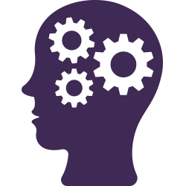
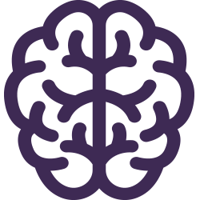


Job Aid on Unpacking and Managing Your Unconscious Biases
What is unconscious bias?
It refers to unintended and subtle thoughts, strong attitudes and beliefs that happen to us all the time.
How do biases work?
Our brains take shortcuts based on our own personal experiences. They tend to categorize people based on characteristics such as age, gender, race, religion, sexual orientation, and abilities/disabilities.
BIAS
Lack of neutrality
Lack of fairness
Micro-aggressions
Micro-inequities
How can biases affect the workplace?
Biases can result in a lack of neutrality and fairness in decision-making (i.e. hiring or promotion), as well as manifestations of micro-aggressions and micro-inequities (i.e. degrading comments or inappropriate non-verbal gestures).
Strategies for Identifying and Managing Your Unconscious Biases
Self-reflect to be more aware about yourself and others. Think about your own privileges and challenge your assumptions.
Try to identify your own biases and take intentional actions to block or manage them. Take the Implicit Association Test (IAT) (part of Harvard’s Project Implicit research project). Notice your reactions and your filters.
Embark on a journey of perspective-taking. Actively listen to others to understand their perspective. Increase your exposure to people with different backgrounds.
Prefer rational rather than intuitive thinking. Be aware of your biases and be prepared when conducting activities such as performance evaluations or promotion decisions. Adopt rationale thinking (conscious, deliberate, slow and effortful) rather than intuitive thinking (unconscious, emotional, fast and effortless). Use facts and data and challenge assumptions.
Foster a respectful and positive culture of micro-affirmations. Listen actively and use inclusive language. Encourage and acknowledge the input and contribution of others.
Adopt an inclusive mindset and outlook during each step of the process when developing, renewing or updating policies and directives or when managing projects.
Empower yourself and others to call out exclusive interactions in the workplace, such as meetings and decision-making.
Keep up and enjoy the journey! Keep self-reflecting. Keep learning. Be curious. Practise, Repeat.
DIVERSITY + MANAGING UNCONSCIOUS BIAS =
A HIGHER-PERFORMING, POSITIVE, INNOVATIVE AND INCLUSIVE WORKPLACE

